Slide 1



Federated Health Information Model (FHIM) Profile Builder
Federal Health Information Model Architecture Team (FHIM A-Team), Apprio Inc
Steve Wagner, Galen Mulrooney, Jay Lyle, Sean Muir, Ioana Singureanu, Rob McClure, Steve Hufnagel
Jason Lee, Director, OpenGroup Healthcare Vertical
July 30, 2019

Slide 2
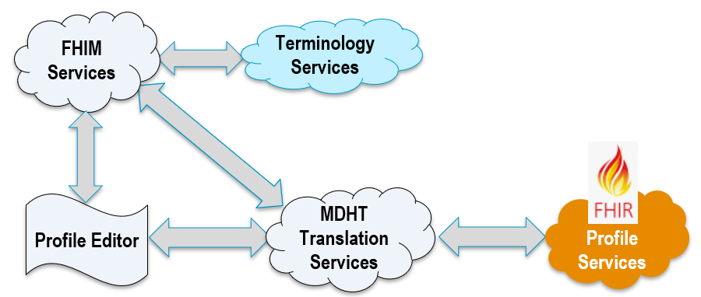
FHIM Profile Builder
Introduction

Slide 3
What Is The Federated Health Information Model (FHIM)
The FHIM is a model of Health Data. It harmonizes content (information, terminologies and value sets) across government, private sector and standards organizations. It provides an integrated picture of health information, the provenance of that information and the context of that information. The FHIM can be used to generate health information exchange standards (e.g., FHIR profiles) that support the interoperable exchange of information between health organizations.

Slide 4
Why Do We Need the FHIM
One of the highest value propositions for the FHIM lies in its ability to assist developers and clinical stakeholders by building interoperability components, using HL7 FHIR, CDA, V2, etc. which can be used by other developers and stakeholders (without special effort) in their APIs, component’s and services.
FHIR is immensely popular, in large part because it is easy to use and solves the data transfer problem in interoperability.
However, FHIR, by design, does not ensure that health data that is meaningfully shared in one implementation instance can be meaningfully shared in any other implementations.
As a result, the widespread adoption of FHIR is producing thousands of profiles that cannot be reused without special effort.
A FHIM profile builder would assist the FHIR, CDA, V2 communities by producing consistent-reusable standard-based profiles, and thereby help significantly advance interoperability.

Slide 5
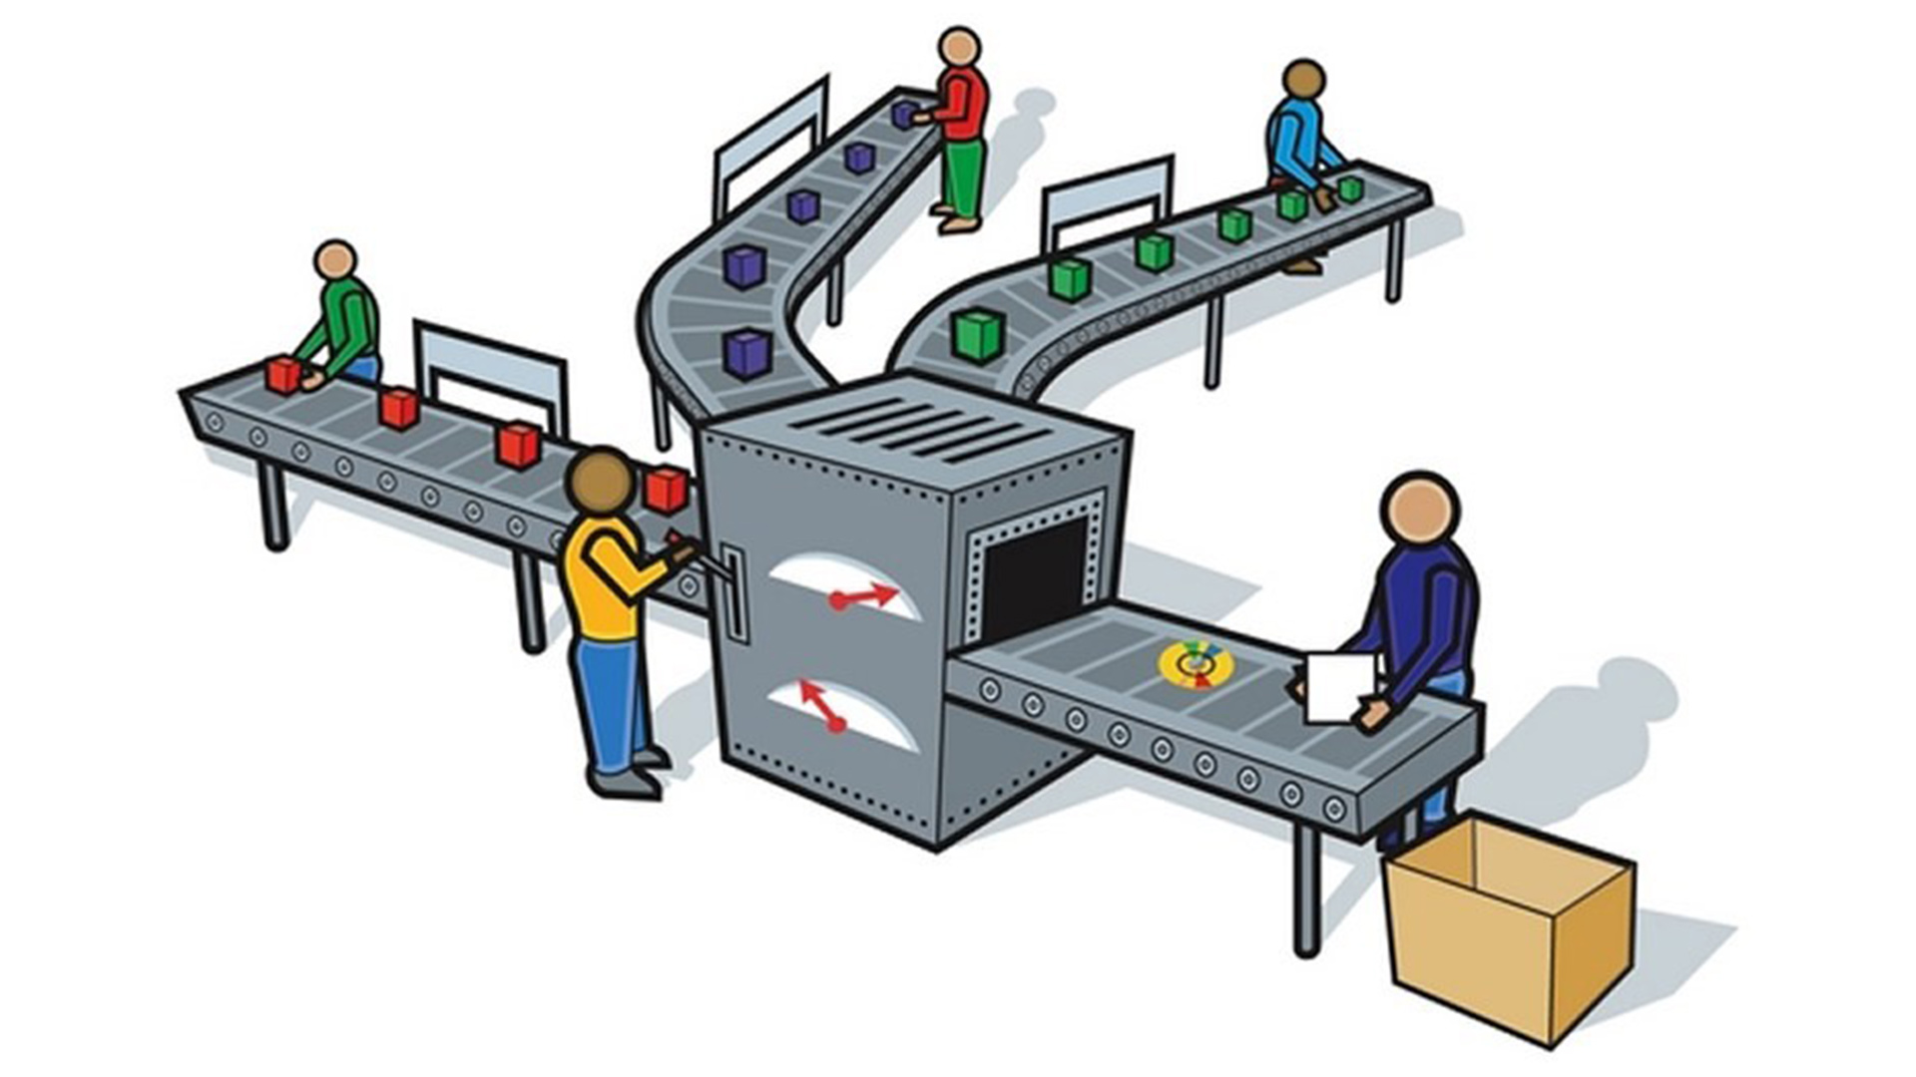

FHIM Profile Builder (FPB) Operations
3. Terminology
2. FHIM
5. FHIR
Implementation Guide
1. Use Case
4. MDHT Transformation

Slide 6
FPB Operations - High Level Overview (FHIR example)
Step 1) Define the Use Case describes the business scenario for the exchange, for example sending patient conditions to the SSA to determine disability status.
Step 2) Use/Extend/Constrain the FHIM to define the structural information components of the exchange (Patient, Gender, Substance Administration, Health Concern, etc.)
Step 3) The Terminology value sets defined in the FHIM extend the model. The value sets are used to define content restrictions (semantics) on information components. An example is setting the possible values for the Administrative Gender to Male, Female, Unknown
Step 4) MDHT Model Transformation Services are able to compare and contrast the FHIM content with the target platform standard (FHIR) and create the platform specific models used to generate the FHIR Profiles and Implementation Guides
Step 5) Publish the resulting FHIR implementation guide with FHIR profiles

Slide 7
FPB Operations - Detailed Description (FHIR example)
The FHIM is an example of a Domain Specific Model (DSM) whose focus is to define health information exchange requirements. DSM’s help support higher levels of abstraction and simplify the methodology. The FHIM has modeled a series of health exchange components which can be mixed, matched, and specialized to easily define a specific information exchange use case and the corresponding information needed to implement such an exchange. The addition of the FHIM User Interface (UI) has simplified this even more to breakdown the requirements to the simplest level used in exchanges.
One aspect of most DSMs is the ability to leverage the model to generate consumables such as reports, web pages, documentation, test cases, and source code. The FHIM is used to generate such consumables but the FHIM itself is agnostic to a particular standard such as HL7 FHIR or HL7 CDA. The FHIM DSM uses other DSMs to support a broader range of exchange definitions. In particular, the FHIM leverages DSMs for CDA, NIEM, and FHIR. This example will focus on the FHIR DSM.
Step 1) Define the Use Case (scope). Scope essentially is the list of domain components required for the exchange
Step 2) Identify which components from the FHIM can be used to satisfy these requirements. (Model additional information in the FHIM to support the requirements if necessary) Using the FPB UI apply any specializations for the exchange definition. Typical specializations are to set an element of the FHIM to required or not required for the exchange. (Example: If part of the use case requires support for a workflow/process that needs the BMI you could set the height and weight attributes of the patient to required. Whereas if the exchange was focused on the eligibility of the patient for disability, patient allergies would not be required.)

Slide 8
FPB Operations - Detailed Description Continued (FHIR example)
Step 3) Specify terminology requirements. A full discussion of the application of terminology requirements is beyond the scope of this presentation but the general intent is to explicitly define the semantics and contents of the information exchange components. This is done through a series of UML profiles on the FHIM model itself.
Step 4) Transform the FHIM DSM into the FHIR DSM. For a FHIR implementation a java base model comparison approach is used to transform the requirements in the FHIM DSM to the FHIR DSM. The FHIR DSM that is generated produces the FHIR Structured Definitions representing the requirements originally defined in the FHIM.
As an example, we can walk through the process used to generate the US Core profile for Immunizations from the FHIM. The approach uses part of the Model Driven Message Interoperability standard called the Semantic Element Exchange Registry (SEER ) to define the mappings from the FHIM to the corresponding FHIR components. The SEER defines a series of semantically clear definitions used to annotate the FHIM and the FHIR DSM. These annotations are independent and follow a canonical pattern allowing for many-to-many mappings. In other words, you do not need to keep remapping the FHIM every time a new target DSM is defined. The SEER has an element called Immunization which is used to annotate the VaccineEvent in the FHIM and the Immunization resource. Similarly, other elements are annotated such as vaccineCode in both FHIM and FHIR using ImmunizationAdministeredMedicationCode. The names can vary but the SEER is meant to align the semantics of the elements. The FHIM PB will compare and contrast the differences and create the appropriate deltas in the FHIR DSM to represent the requirements in the FHIM such as cardinality or value sets constraints. The FHIR DSM then produces the Structured Definition for the elements.

Slide 9

FPB Services
Profile Generator
FHIM
Services
Terminology Services
MDHT
Translation Services
FHIR
Profile
Services
Profile Editor

Slide 10
FPB 2019 Demo
FHIR is Fast Healthcare Interoperability Resources
MDHT is Model Driven Health Tool.
STU is Standard for Trial Use.
UML is Unified Modeling Language.
Profile Editor
Use Case Constraints
FHIR API
(StructureDefinition)
FHIR Operation
($generate)
FHIR
STU4
Profiles
MDHT
Services
(FHIR
STU4)
Profile Generator
FHIM UML Repository

Slide 11
FHIM Profile Builder Service Platform Vision Supports Many Information Exchange Standards
Profile Editor
FHIM
Services
Profile
Services
Terminology Services
NIEM
Profile
Services
CDA
Profile
Services
FHIR
Profile
Services
V2
Profile
Services
MDMI
Semantic Services
MDHT
Translation Services

Slide 12
How FHIM Helps Address Implementation Syntax-and-Semantic Variability Problems
The FHIM harmonizes across standards and organizational requirements.
It is a single model that contains content needed to create holistic FHIR profiles.
Having a common model was the HL7 V3 goal. FHIM can meet this goal.
The FHIM can ensure that FHIR profiles provide consistent meanings, when developed or used by different users and that they meet use case requirements.
Externally specified certification rules an be used for validation testing.
FHIM could be a way for government organizations to communicate data requirements which can lead to interoperable standards implementations
USCDI, MU, information blocking, etc.

Slide 13
How FHIM Helps Address Implementation Syntax-and-Semantic Variability Problems
The FHIM can stay current through contributions from its stakeholders by adding new requirements-specifications mapped to CDA, FHIR, V2 and other standards.
The FHIM Profile Builder provides the machinery to generate consistent FHIR profiles and CDA template Implementation Guides.
The FHIM Profile Builder:
Consists of two components - a profile editor and a profile generator
Makes the FHIM easier to use (by removing the need to interact directly with UML)
Provides a user interface that makes it easier
to consistently create reusable FHIR Profiles based on FHIM templates.
to build FHIR profiles that support specific use cases.
Generates Interoperability Guides for CDA, FHIR and other information exchange standards such as NCPDP (pharmacy), X12 (financial/payor), DICOM (imaging)

Slide 14
FHIM Profile Builder
FHIM
Services
Terminology Services
Profile Generator Services
FHIR
Profile
Services
Profile Editor

Slide 15



Legend
Business requirements
User interface design
Actual Implementation

Slide 16
FPB: Profile editor overview
2019-07-01
A component of the FHIM Profile Builder
A web-based tool intended for business analysts and integrators (users)
It allows users to identity what data elements are necessary to fulfill one or more interoperability use cases and define the contents of a standard-based transaction or resource
The user may create a FHIM Template by retrieving a FHIM class and identifying which data elements are mandatory, supported, or not supported according to their implementation requirements/use cases
The user can save a template for further editing or
The user can invoke the FHIM Profile Generator to create a FHIR profile based on the data elements in the template

Slide 17
FPB: Profile editor overview (continued)
2019-07-01
It uses FHIR StructureDefinition to retrieve class and template information from FHIM and store new FHIM templates
It also uses the FHIR Bundle resource to manage the results of a “search” operation
The web user interface uses
React
Material Design - lightweight
Google Firebase authentication
Github repository: https://github.com/FHIMS/FHIMProfileBuilderWeb

Slide 18
FHIM Templates
2019-07-01
They represent the blueprint for generating a standard-specific profile or profile needed for a project
Current target is HL7 FHIR profiles
They are created/designed by implementers who have identified one or more interoperability use cases
They identify what data elements in FHIM are necessary to meet the implementers’ use cases
FHIM templates constrain data elements necessary to meet the information exchange requirements for the use cases.
Templates identify mandatory, supported, and not supported data elements.
MANDATORY: these data elements must appear in every information exchange, they cannot be null. Implementers must collect, display, and store these data elements.
SUPPORTED: these data elements are required but may be omitted in some exchanges if the information not available. Implementers have to make every effort to collect and store these data elements.
NOT SUPPORTED: these data elements appear in FHIM – are part of a class – but they are not necessary for the use cases and are not collected, displayed, or stored by systems that otherwise meet the requirements of the use cases.
Generated FHIR profiles: provide a FHIR representation of the data elements selected by the user; if a data element is marked as “not- supported” in the Profile Editor, the Profile Generator may omit the data element if it was not mapped to a FHIR data element. If the mapping exists, the data element carnality is set to 0..0 (to mark it as “not supported” in the FHIR resource).
FHIM templates are incorporated into Implementation Guides

Slide 19
Use of Profiles for Conformance Testing/Validation
2019-07-01
Conformance testing requires unambiguous, testable definitions for information exchanges using a standard based syntax;
Semantic interoperability requires a common model of content (i.e. data required to meet the exchange requirements) ; FHIM defines a common set of data elements organized into classes and provides a common model of content
FHIM contains the logical “content model” for a FHIR profile or CDA template generated from a FHIM structure
The generated profiles can be used to test and validate standard implementations for certification at runtime
Which data elements are mandatory/supported/not supported
How the data is represented or coded
FHIM can support any standard syntax and create equivalent profiles (e.g. CDA, FHIR) that share a common model of content
Since FHIR is extensible, FHIM-based profile generation supports the management and harmonization of extensions across projects/organizations and
Avoids duplicate extensions
Reuses extensions across a jurisdiction (e.g. US)

Slide 20
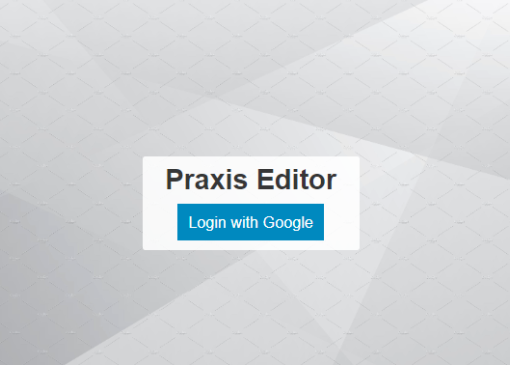

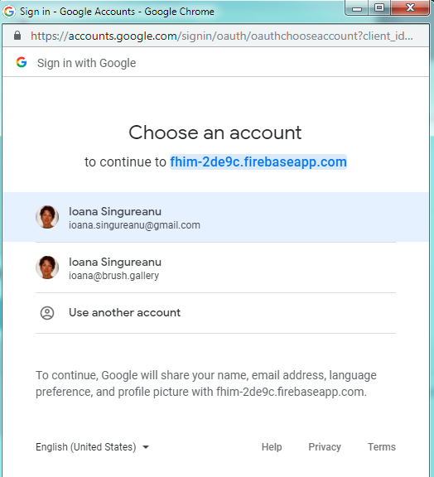
Login screen
Google OAuth2 developer SDK (firebase)
Future enhancement:
This capability should reuse Open Group authorization server intended to give members access to tools and resources
Profile

Slide 21
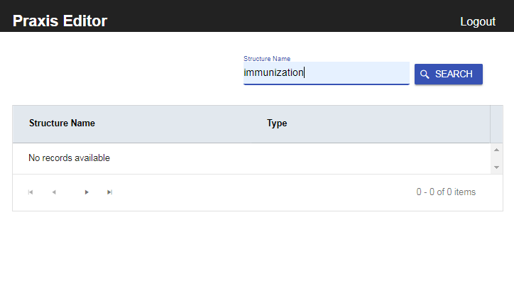
Search
Enter a “structure name” to search classes and templates defined in FHIM
The search string will use the structure name:
Class name
A composite name for Template
Base class name
Organization
Template title
Template version
Profile Editor

Slide 22
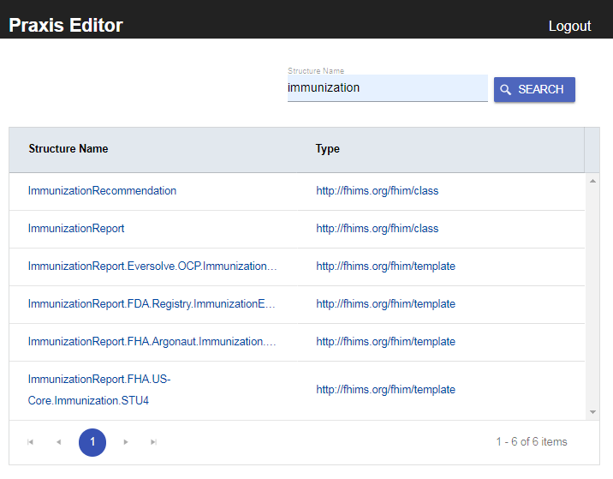
Profile Editor
Search
The structured returned from the server are displayed by “structure name” and “type”
They can be sorted by those columns
By default they are all sorted by class name
This way the users can find everything related to the specific class with one query
The structure name consists
The class name if the type is “class”
A composite name for if the type of of structure is “template”
Base class name (E.g. ImmunizationReport)
Organization (e.g FHA)
Implementation Guide (e.g. US-Core, Argonaut, CRN)
Template title (e.g. Immunization)
Template version (e.g. STU4, 1.1, etc.)
classes
templates
FHIM class name
10 entries per page – set by server

Slide 23
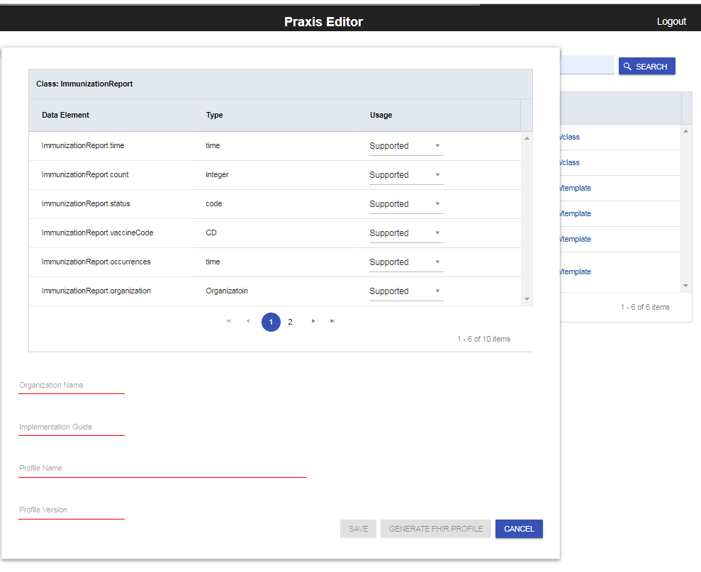
1
Profile Editor
FHIM Class that will be used for the template
Create a template from a FHIM class
If the user selects a class from the list, the user may edit “usage” and metadata:
Organization responsible for the project, implementation guide, and profile
Implementation Guide that contains the template
Template title
Template version

Slide 24
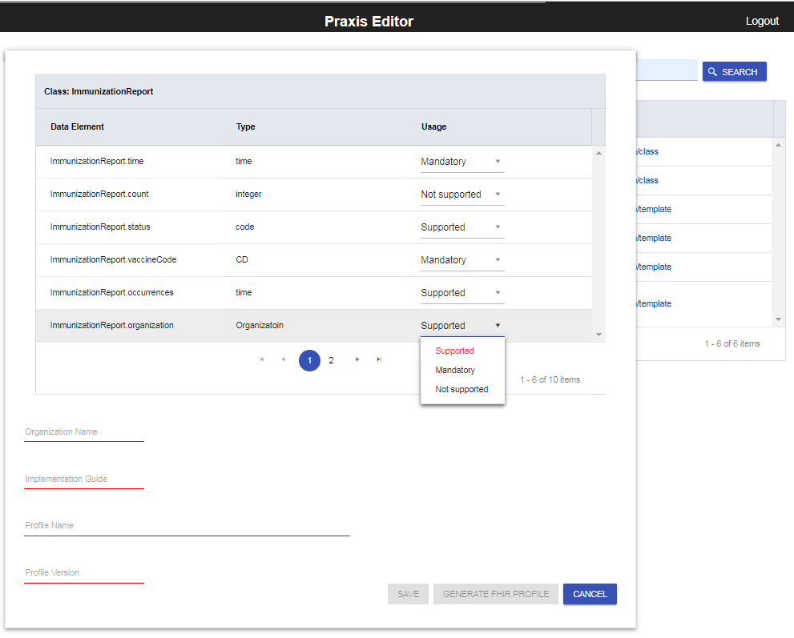
2
Profile Editor
Create a template from a FHIM class
Mandatory
Not supported by the project
If the user identifies which data element/attributes of the FHIM class are either mandatory, supported, or not required or prohibited (not supported).
The Save button is disabled until the metadata is filled out →
Select the usage based on project requirements

Slide 25
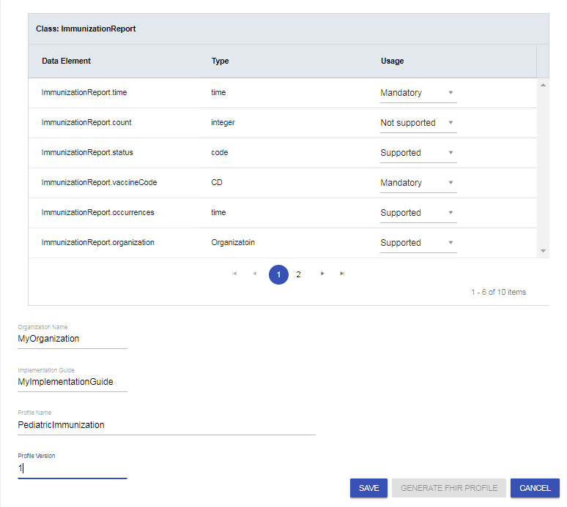
3
Create a template from a FHIM class
The user may go the next page until all the data element/attribute are annotated according to the project requirements.
The Save button is enabled when all the metadata is filled and the profiled can saved in FHIM using its FHIR-based API.
Save will close the template editor and take user back to the search dashboard.
Update all the data elements

Slide 26
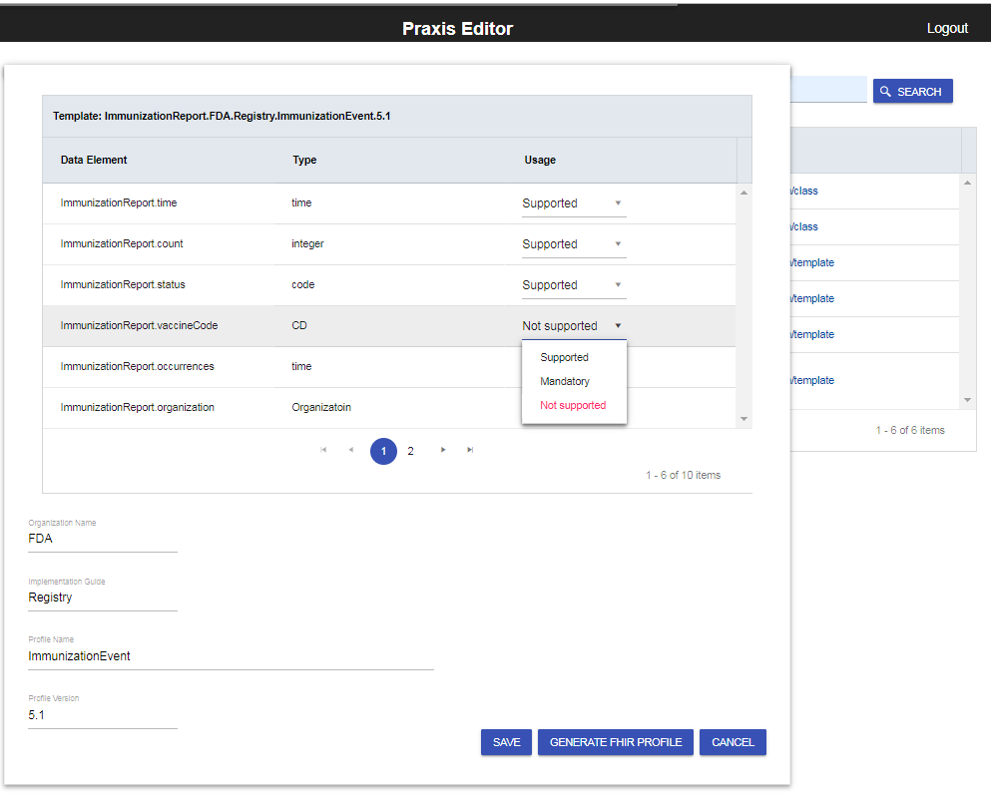
Profile Editor
Edit a template
If the user selects a template from the list of matching results, the user may edit “usage” and metadata:
Organization
Implementation Guide that contains the template
Template title
Template version

Slide 27
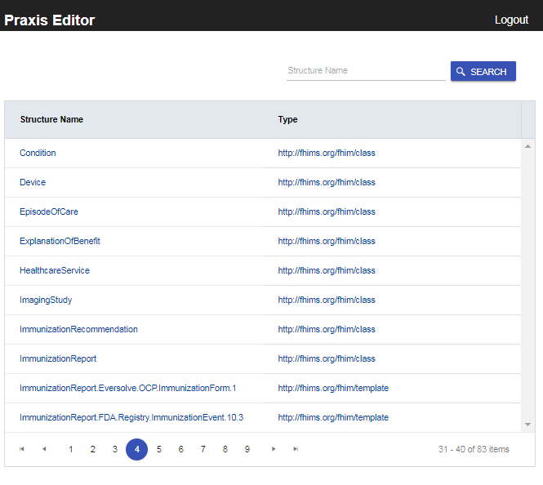
Search – after saving a template
Profile Editor
If the search string is left blank, all the structures will be queried and displayed in alphabetical order, by structure name
Template structure names contain the base class
After saving changes, a search operation will retrieve the latest.
Future enhancement:
Each update creates a new version, future enhancements may access previous versions of a template

Slide 28
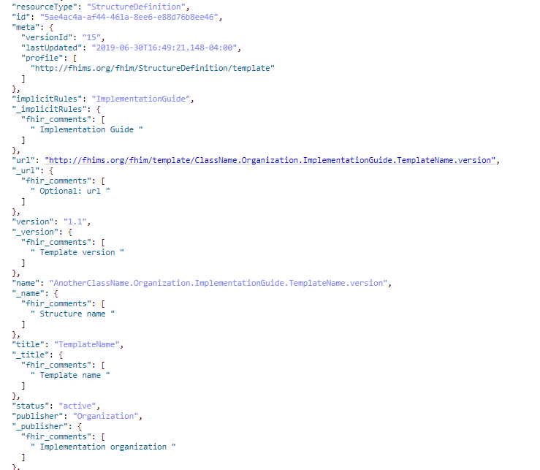
FHIM Template as a StructureDefinition
Implementation Guide
Template Version
Structure Name
Template Name
Organization Name

Slide 29
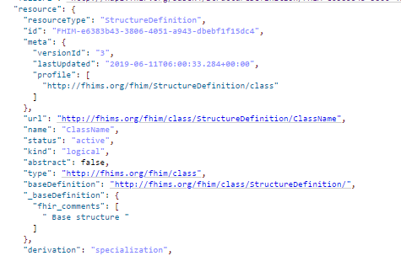
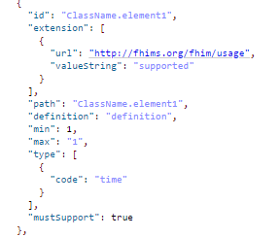
FHIM Class as a StructureDefinition (FHIR R3, R4)
Structure Name
Usage extension
Structure Type

Slide 30
FHIM Class Data Mapping: User interface to StructureDefinition
StructureDefinition elements:
User Interface Labels:
"name": "ClassNameUNeed"
"type": "http://fhims.org/fhim/class"
"snapshot.element[].id”
"snapshot.type[].code”
“snapshot.extension[@url=‘ http://fhims.org/fhim/usage’].valueString”
Structure Name
Structure type
Data Element
Type
Usage

Slide 31
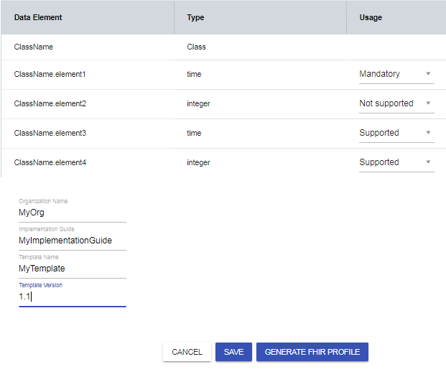
Template attributes
User Interface:
StructureDefinition
"publisher": “MyOrg“
"implicitRules": “MyImplementationGuide“
“title” : “MyTemplate”
"name": is a concatenation of "ClassName.MyOrg.MyImplementationGuide.MyTemplate.ProfileVersion“
“version”: “1.1”

Slide 32
FHIM Profile Builder
Conclusions and Next Steps

Slide 33
Comparison of US Core and FPB Generated FHIR Profiles
Task: Using the FHIM Profile Builder Model Driven Architecture approach, generate the equivalent of US Core FHIR profiles (that were originally developed manually)
Objective: Validate that the FHIM and FPB modeling services can produce high quality, accurate and consistent FHIR profiles that are equivalent to US Core FHIR profiles.
Use Case: The Immunization for US Core FHIR profile. This profile sets the minimum expectations for the Immunization resource to record, fetch and search immunization history associated with a patient. It identifies which core elements, extensions, vocabularies and value sets SHALL be present in the resource when using this profile.
Usage scenarios: for the US Core FHIR Immunization profile are:
Query for immunizations belonging to a Patient
Record immunizations belonging to a Patient
Conclusion: The FPB generated FHIR profiles duplicate the intent and semantics of the original US Core FHIR profiles. Every element detailed in US Core FHIR Profiles were replicated by the FHIM generated version.

Slide 34
FHIM Profile Builder Benefits
The FPB Model Driven Architecture approach addresses both modeling and implementation issues and accelerates creation of FHIR profiles and implementation guides by:
Providing tools that are easier to use and that
Generate profiles and guides more efficiently
With improved accuracy and improved reuse
Making users more effective and productive
Reducing implementation variability
Maintaining traceability to legislation, policies and requirements.

Slide 35
Comparison of US Core and FPB Profiles Using US Core FHIR Exchange Requirements for Immunizations
FHIR US Core Immunization Element | FHIM Vacination Event Element | Congruent
status | status | Yes
statusReason | statusReason | Yes
vaccineCode | vaccineCode | Yes
patient | patient | Yes
occurrenceDateTime | dateTIme | Yes
primarySource | source | Yes

Slide 36
FPB Profile Editor: Future enhancements
2019-07-01
Allow users to organize their profiles into Implementation Guides
Use FHIR ImplementationGuide resource to store the information in FHIM or an associated FHIR server
Create FHIR profiles to describe the constraints needed to represent FHIM logical content as FHIR StructureDefinition resources using the FHIR API specification (Search, Create, Update operations)
Examples provided in Github FPB Profile Editor project: https://github.com/FHIMS/FHIMProfileBuilderWeb
Create a FHIM template based on a another existing FHIM template (e.g., create an organization-specific template from a US-Core specification template)
Change the base structure from a “class” to a “template”

Slide 37
FPB Profile Editor: Future enhancements (continued)
2019-07-01
Connect the Profile Editor to a FHIR Terminology Server to access existing value sets
Support changes to value set members and adding terminology constraints to coded information from the FHIM
Add more options to the Profile Generator in addition to FHIR Profiles Integration with a Terminology Server
Create a set of FHIM templates corresponding to US Core FHIR profiles
These pre-loaded templates can then be used to efficiently create extensions to US Core FHIR Profiles that are conformant to the existing US Core FHIR profiles
A possible Profile Editor enhancement is GoldenLayout https://golden-layout.com/

Slide 38

FHIM Profile Builder Point of Contact:
Jason Lee, Director, OpenGroup Healthcare Vertical
j.lee@opengroup.org
(774) 444-0880 @jasonsleephd
Questions & Discussion
Thank You

Slide 39
Glossary
Binding is the association of a medical term with a terminology or code system or value set, such as SNOMED, LOINC, RxNorm terminology and codes.
Classes: (in information modeling) sets, collections, concepts, types of objects, or kinds of things.
Domain: a set of classes, attributes and relationships that describe a subject area.
Domain Model: a conceptual model of a system which describes the various entities involved in that system and their relationships. In UML modeling, a class diagram is used to represent the domain model.
Element: an item in a UML information model (e.g., class, data attribute, relationship, etc.).
Information Model: (in software engineering) a representation of concepts, relationships, constraints, rules and operations to specify data semantics for a chosen domain of discourse. It can provide sharable, stable, and organized structure of information requirements for the domain context.
Logical Information Model: (in systems engineering) a representation of information, organized in terms of classes and relationships and is independent of any particular technology (database) platform. The logical information model can become the basis of a physical data model and inform the design of a database. Logical information and physical data models are very different in their objectives, goals and content.
Physical Data Model: a representation of a data design which takes into account the facilities and constraints of a given database management system.
Reusable: implies that an IT component has been modularized, standardized and tested so that it can be efficiently and effectively used, in similar contexts, by others.
Semantic Data Model: (in software engineering) a data modeling technique to define the meaning of data within the context of its interrelationships with other data. A semantic data model is an abstraction which defines how the stored symbols relate to the real world. A semantic data model is sometimes called a conceptual data model.
Terminology: is the study of terms and their use. Terminology denotes a formal discipline which systematically studies the labeling or designating of concepts particular to one or more subject areas of human activity, through research and analysis of terms in context, for the purpose of documenting and promoting correct usage.
Notes:
Think we need a slide that describes what the FHIM is. Can take from website content already created. Def needs to discuss the distinct information and terminology modeling components, and the binding idea. Binding is another term that needs to be defined in our glossary.
See slides 9 and 10.

